Slide 1
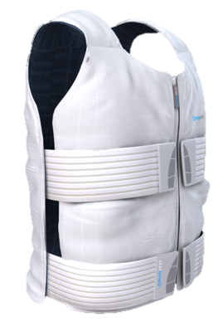
Heat Conference
Heat-Acclimatisation and Pre-Cooling:
A further boost
for endurance performance?
Cyril Schmit – PhD student
Research department, INSEP
With Yann Le Meur, Rob Duffield,
Aaron Coutts & Christophe Hausswirth

Slide 2
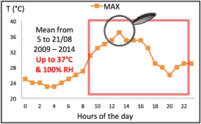
Performing in the heat: only the beginning
CONTEXT
Increasing amount of competitive events occurring in the heat.
Various existing strategies!
Optimisation…

Slide 3
Exercising in the heat: Closer to the field
Guy et al.,
Sp Med, 2014
Endurance performance
RATIONALE
20km
Time-Trial
Heat-Acclimation modalities
Heat
Acclimatisation
35°C
50% RH
Ice vest
Pre-Cooling strategies
Thermal environment
Altitude: 380 m
Area: 1260 km

Slide 4
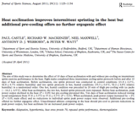
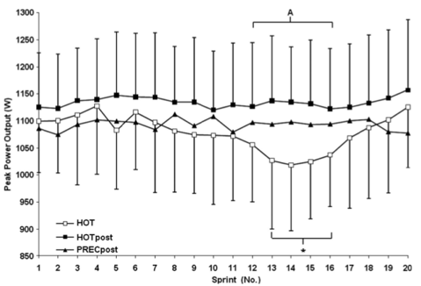
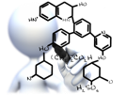
Exercising in the heat: Closer to the field
Brade et al., JSS 2013
Castle et al., JSS 2011
Control session ?
Monitoring ?
Protocol
Cooling / Sprints !
33°C - 55% RH
__________________
20x
(5” sprint –
115” recovery)
__________________
Pre-cooling Post-HA
Cooling / Endurance !
RATIONALE
Practical
Theoretical
20min
Ice packs (-16°C)
Hypothesis:
HA → +
PC → +
HA*PC → ++

Slide 5
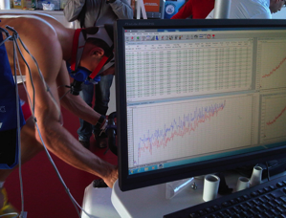
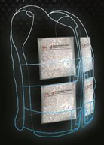
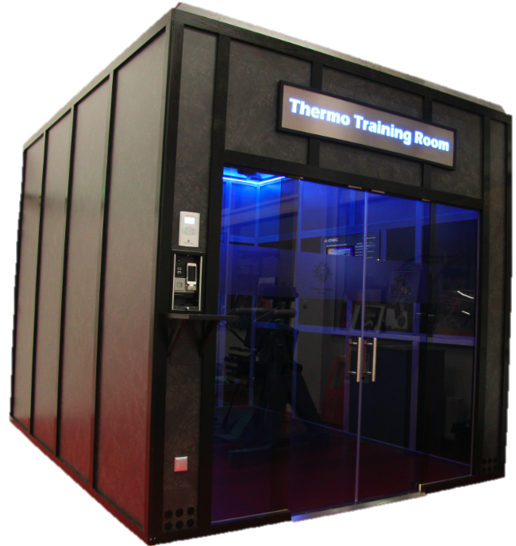
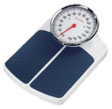
Exercising in the heat: Closer to the field
13 triathletes
31 ± 4 y
64.9 ± 6.9 ml·kg⁻¹·min⁻¹
MAP 406 ± 34 W
CryoVest®
Paris
.
PROTOCOL
VO_{2max} test
Familiarisation
.
.
Heart rate
6 weeks
USG
Motivation
Fatigue
DOMS
RPE
TC
Tskin Tcore
Sweat loss
Rest
Warm-up
20km Time-Trial
Distance only
5 min
50% MAP
10 min
Passive
10 min
100 W
Fan
Ad libitum

Slide 6
Exercising in the heat: Closer to the field
13 triathletes
31 ± 4 y
64.9 ± 6.9 ml·kg⁻¹·min⁻¹
MAP 406 ± 34 W
Heat Tolerance Test
Usual training volume:
14 ± 2h/week
30 min
50% MAP
TC
Tskin Tcore
Sweat loss
Paris
Pointe-à-Pitre
Paris
.
PROTOCOL
VO_{2max} test
Familiarisation
PV + HTT
8-day
Training camp
30 ± 5°C
75 ± 14% RH
~16h/d outdoor
PV + HTT
.
.
Heart rate
6 weeks
USG
Motivation
Fatigue
DOMS
RPE
TC
Tskin Tcore
Sweat loss
Rest
Warm-up
20km Time-Trial
Distance only
5 min
50% MAP
10 min
Passive
10 min
100 W
Fan
Ad libitum

Slide 7
Pre-Cooling * Heat-Acclimatisation
Paris
Pointe-à-Pitre
Paris
.
VO_{2max} test
Familiarisation
PV + HTT
PV + HTT
RESULTS - DISCUSSION
8-day
Training camp
249 ± 38 W
.
.

Slide 8
Pre-Cooling * Heat-Acclimatisation
Paris
Pointe-à-Pitre
Paris
.
VO_{2max} test
Familiarisation
PV + HTT
8-day
Training camp
PV + HTT
.
.
Beneficial - Likely moderate
RESULTS - DISCUSSION
+10 ± 18 W -25 ± 64 sec
+4.4 ± 4.6% -1.2 ± 1.6%
Ice-Vest PC
≈30min / 30min
249 ± 38 W
+14 ± 29 W
+13 ± 23 W
+11 ± 19 W
+2 ± 22 W

Slide 9
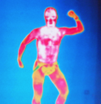
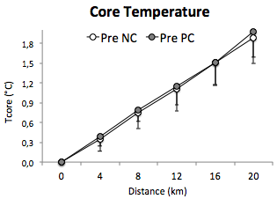
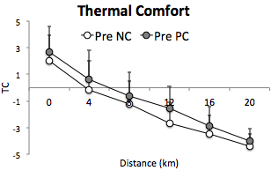
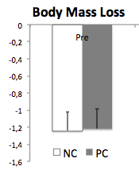
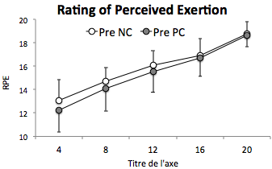
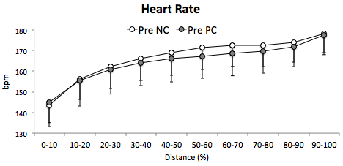
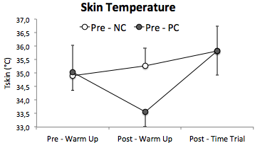
Pre-Cooling * Heat-Acclimatisation
Paris
Pointe-à-Pitre
Paris
.
VO_{2max} test
Familiarisation
PV + HTT
8-day
Training camp
PV + HTT
.
.
*
RESULTS - DISCUSSION
+10 ± 18 W -25 ± 64 sec
+4.4 ± 4.6% -1.2 ± 1.6%
*
*
*
Skin
Blood Flow
 Convection / Conduction

Slide 10
Pre-Cooling * Heat-Acclimatisation
Paris
Pointe-à-Pitre
Paris
.
VO_{2max} test
Familiarisation
PV + HTT
8-day
Training camp
PV + HTT
.
.
Beneficial – Almost certain Very large
Acclimatisation status
i.e.,  PV,  Tcore,  TC,
 sweat Na⁺
RESULTS - DISCUSSION
+28 ± 19 W -01:17 ± 00:58 min
+11.3 ± 4.4% -3.9 ± 1.5%
249 ± 38 W

Slide 11
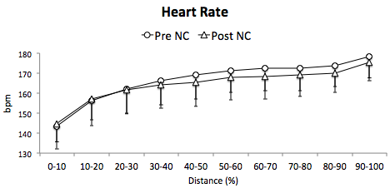
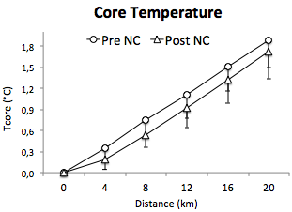
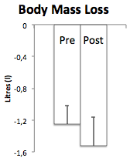
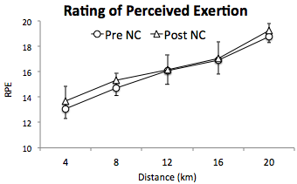
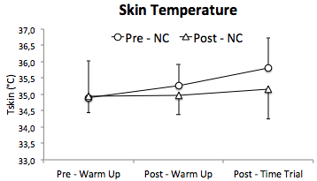
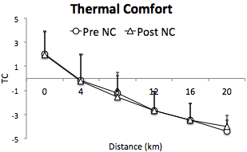
Pre-Cooling * Heat-Acclimatisation
Paris
Pointe-à-Pitre
Paris
.
VO_{2max} test
Familiarisation
PV + HTT
8-day
Training camp
PV + HTT
.
.
RESULTS - DISCUSSION
*
+28 ± 19 W -01:17 ± 00:58 min
+11.3 ± 4.4% -3.9 ± 1.5%
*
*
*
*
*
*
*
 Plasma volume
Thermoregulatory adjustments
*
*
*
*

Slide 12
Pre-Cooling * Heat-Acclimatisation
Paris
Pointe-à-Pitre
Paris
.
VO_{2max} test
Familiarisation
PV + HTT
8-day
Training camp
PV + HTT
.
.
Beneficial – Unclear small
RESULTS - DISCUSSION
+4 ± 14 W -06 ± 42 sec
+1.4 ± 3% -0.3 ± 0.1%
277 ± 37 W

Slide 13
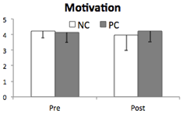
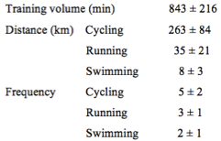
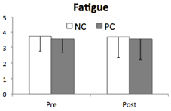
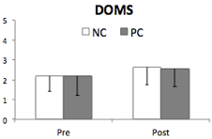
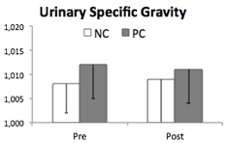
Pre-Cooling * Heat-Acclimatisation
Paris
Pointe-à-Pitre
Paris
.
VO_{2max} test
Familiarisation
PV + HTT
8-day
Training camp
PV + HTT
.
.
Beneficial - Likely moderate
Beneficial – Unclear small
RESULTS - DISCUSSION
Paris
Training camp
Post
Tskin
But
- No  perf

Slide 14
Pre-Cooling * Heat-Acclimatisation
Paris
Pointe-à-Pitre
Paris
.
VO_{2max} test
Familiarisation
PV + HTT
8-day
Training camp
PV + HTT
.
.
RESULTS - DISCUSSION
HA blunts PC-related physiological effects
Tskin
 Plasma volume
Active + passive phases
Training volume of triathletes
Cardiac strain
Thermoregulatory adjustments
 Convection / Conduction

Slide 15
Pre-Cooling * Heat-Acclimatisation
Paris
Pointe-à-Pitre
Paris
.
VO_{2max} test
Familiarisation
PV + HTT
8-day
Training camp
PV + HTT
.
.
Kinetic =, magnitude ≠
PC effect / HA level ?
Correlation
r = 0.58
PC intensity / HA level ?
Correlation
r = 0.42
Individual changes
in thermal comfort
Individual changes
in performance
Perception
RESULTS - DISCUSSION
+5 ± 25 W
+5 ± 19 W
+3 ± 21 W
+2 ± 16 W
+14 ± 29 W
+13 ± 23 W
+11 ± 19 W
+2 ± 22 W

Slide 16
Pre-Cooling * Heat-Acclimatisation : THM
Paris
Pointe-à-Pitre
Paris
.
VO_{2max} test
Familiarisation
PV + HTT
8-day
Training camp
PV + HTT
.
.
Pre – NC
Pre – PC
Post – NC
Post – PC
RESULTS - DISCUSSION
249 ± 38 W
+10 ± 18 W
+4.4 ± 4.6%
277 ± 37 W
+4 ± 14 W
+1.4 ± 3%
Merci de
votre attention
Convergent physiological effects
Perceptive effects on performance

Slide 17
Heat Conference
Heat-Acclimatisation and Pre-Cooling:
A further boost
for endurance performance?
Cyril Schmit – PhD student
Research department, INSEP
With Yann Le Meur, Rob Duffield,
Aaron Coutts & Christophe Hausswirth

Slide 18
HA-Related Adaptations
a
b
.
.
.
*
.
.
.
.
.
.
.
.
HTT
Pre Post
.
Pre Post
c
d
.
*
.
.
.
.
*
.
Pre Post
Pre Post

